Slide 1
Introduction to Paired RDDs
Paired RDD is a distributed collection of data with the key-value pair. It is a subset of Resilient Distributed Dataset So it has all the features of RDD and some new feature for the key-value pair. There are many transformation operations available for Paired RDD. These operations on Paired RDD are very useful to solve many use cases that require sorting, grouping, reducing some value/function.
Commonly used operations on paired RDD are: groupByKey() reduceByKey() countByKey() join() etc.

Slide 2
Introduction to Paired RDDs
Paired RDDs are a special type of RDD in Apache Spark that contain key-value pairs. They are also known as key-value RDDs. Paired RDDs are very useful for many data processing tasks, such as:
Joining two datasets together
Grouping data by a key
Aggregating data by a key
Sorting data by a key

Slide 3
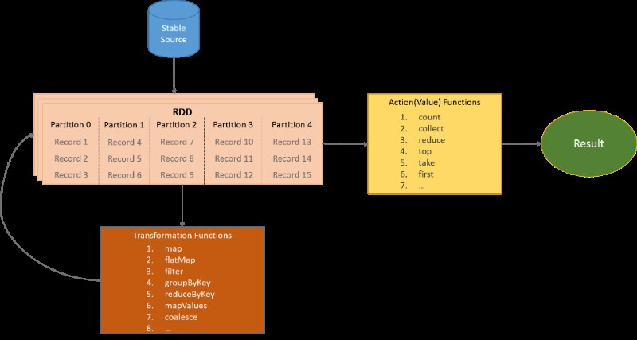
Introduction to Paired RDDs

Slide 4
Introduction to Paired RDDs
Here is an example regarding creating of paired RDD:
val pRDD:[(String),(Int)]=sc.textFile(“path_of_your_file”)
.flatMap(line => line.split(” “))
.map{word=>(word,word.length)}

Slide 5
Introduction to Paired RDDs
To create a paired RDD, you can use the map() transformation to map each element of an existing RDD to a key-value pair. For example, the following code creates a paired RDD from a text file, where the key is the word and the value is the number of times the word appears in the file:

Slide 6
Introduction to Paired RDDs
import re
sc = SparkContext()
text_file = sc.textFile("myfile.txt")
words = text_file.flatMap(lambda line: re.split(r"\W+", line))
word_counts = words.map(lambda word: (word, 1))

Slide 7
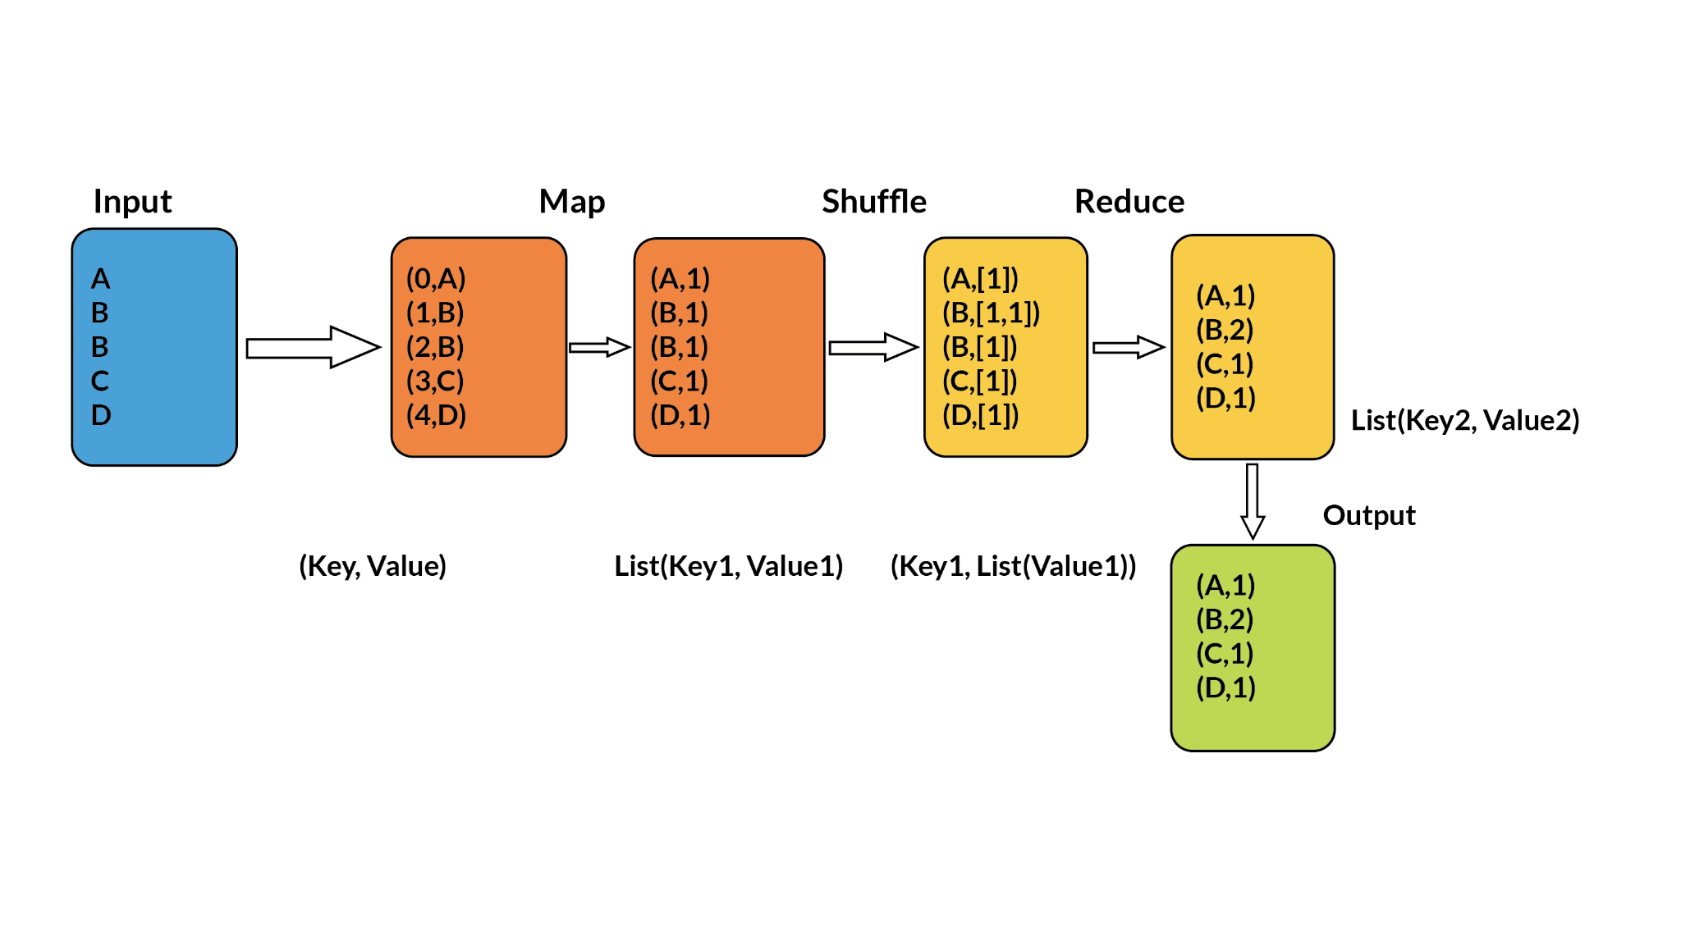
Introduction to Paired RDDs

Slide 8
Operations on Paired RDDs
Paired RDDs support a variety of operations that can be used to perform powerful data processing tasks. Some of the most common operations on paired RDDs include:
reduceByKey(): Reduces the values associated with each key to a single value. This operation is often used to aggregate data, such as counting the number of times each word appears in a text file or calculating the average sales for each product category.

Slide 9
Operations on Paired RDDs
groupByKey(): Groups the elements of the RDD by key. This operation is often used to analyze data by category or group, such as analyzing customer spending by region or product category.
join(): Joins two paired RDDs together on a common key. This operation is often used to combine data from different sources, such as joining customer information from a CRM system with order data from an e-commerce platform.
sortByKey(): Sorts the elements of the RDD by key. This operation is often used to generate reports or dashboards, such as a list of the top 10 products by sales or the customers with the highest spending.

Slide 10
Operations on Paired RDDs
groupByKey(): Groups the elements of the RDD by key. This operation is often used to analyze data by category or group, such as analyzing customer spending by region or product category.
join(): Joins two paired RDDs together on a common key. This operation is often used to combine data from different sources, such as joining customer information from a CRM system with order data from an e-commerce platform.
sortByKey(): Sorts the elements of the RDD by key. This operation is often used to generate reports or dashboards, such as a list of the top 10 products by sales or the customers with the highest spending.

Slide 11
Examples:
Counting the number of times each word appears in a text file:
import re
sc = SparkContext()
text_file = sc.textFile("myfile.txt")
words = text_file.flatMap(lambda line: re.split(r"\W+", line))
word_counts = words.map(lambda word: (word, 1))
word_counts = word_counts.reduceByKey(lambda x, y: x + y)

Slide 12
Examples:
Generating a list of the top 10 products by sales:
product_sales = sc.textFile("product_sales.csv")
product_sales_by_product_id = product_sales.map(lambda line: (line.split(",")[0], float(line.split(",")[1])))
top_10_products = product_sales_by_product_id.reduceByKey(lambda x, y: x + y).sortByKey(False).take(10)

Slide 13
Introduction to Structured APIs
Structured APIs are a set of APIs in Apache Spark that provide a high-level abstraction for working with data. They are designed to make it easy to perform common data processing tasks, such as filtering, sorting, aggregating, and joining data.
Structured APIs are built on top of Spark's Resilient Distributed Datasets (RDDs). RDDs are a low-level abstraction for working with data in Spark. They are distributed across multiple machines and can be processed in parallel.

Slide 14
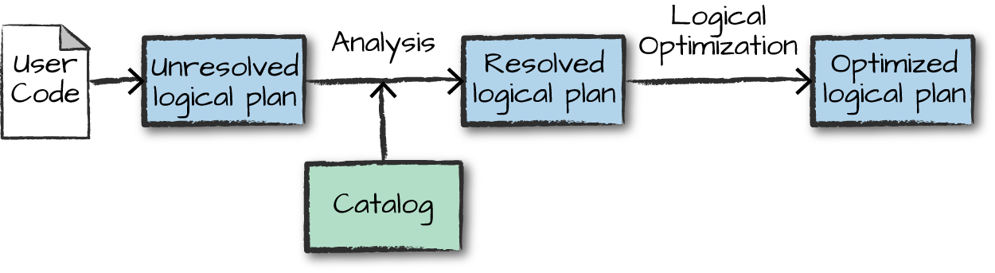
Introduction to Structured APIs

Slide 15
Introduction to Structured APIs
Structured APIs are available in two flavors: DataFrames and Datasets.
DataFrames: DataFrames are a tabular representation of data. They are similar to spreadsheets, with rows and columns. DataFrames are a good choice for working with structured data, such as data from a relational database.
Datasets: Datasets are a more powerful representation of data than DataFrames. They provide additional features, such as type safety and support for complex data types. Datasets are a good choice for working with complex data, such as data from a graph database or JSON data.

Slide 16
Dataframes and Datasets
High-level API: Code written using dataframe abstraction is structured just like dataframes in pandas. The code is highly readable and easy to write. Therefore, it becomes accessible to a lot of people other than specialists like data engineers or data scientists.
Memory management: Transformations on RDDs are performed in executors. These transformations take place in the heap memory of the executors, which are essentially Java Virtual Machines(JVMs). On the other hand, Dataframes use off-heap memory in addition to the heap memory on JVMs. Hence, managing both heap and off-heap memory requires custom memory management. As you go through the next couple of points, you will understand why it is beneficial to utilise off-heap memory.

Slide 17
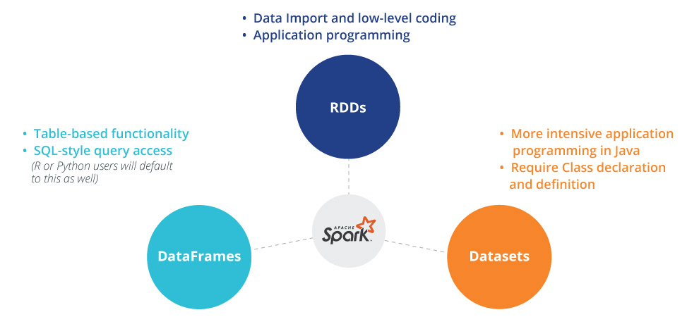
Introduction to Structured APIs

Slide 18
Getting Started With Dataframe APIs
Some of the important commands are as follows:
spark.sparkContext.parallelize(): This command is used to parallelise data in Spark. It takes a collection of elements and distributes them across the Spark cluster, creating a Resilient Distributed Dataset (RDD).
collect(): This command retrieves all the data elements from an RDD or a dataframe and returns them as a local collection in the driver program.
toDF(): This command converts an RDD into a dataframe in Spark. It infers the schema (column names and data types) of the data and treats each element in the RDD as a row in the resulting dataframe.

Slide 19
Getting Started With Dataframe APIs
printSchema(): This command displays the schema (column names and data types) of a dataframe in a structured and readable format. It helps users understand the structure of the dataframe by providing information about the columns and their corresponding data types.
show(): This command displays the contents of a dataframe in a tabular format. It presents a concise representation of the dataframe’s data, showing a limited number of rows in a visually appealing table format.
By leveraging these commands and techniques, you can efficiently create, manipulate and analyse dataframes in PySpark. The ability to work with structured data in a tabular format provides a powerful tool for data processing and analysis in various real-world scenarios.

Slide 20
Create a Dataframe from RDDs
To create a DataFrame from an RDD in Spark, you can use the toDF() method. The toDF() method takes a list of column names as an argument and returns a DataFrame with the specified column names.
For example, the following code creates a DataFrame from an RDD of (name, age) pairs:

Slide 21

Create a Dataframe from RDDs
import pyspark.sql.functions as F
sc = SparkContext(appName="CreateDataFrameFromRDD")
rdd = sc.parallelize([("Alice", 25), ("Bob", 30)])
df = rdd.toDF(["name", "age"])
df.show()

Slide 22
Create dataframes from Pandas dataframes
To create a DataFrame from a Pandas DataFrame in Spark, you can use the spark.createDataFrame() method. The spark.createDataFrame() method takes a Pandas DataFrame as an argument and returns a Spark DataFrame.
For example, the following code creates a Spark DataFrame from a Pandas DataFrame:

Slide 23
Create dataframes from Pandas dataframes
import pandas as pd
from pyspark.sql import SparkSession
# Create a Pandas DataFrame
pdf = pd.DataFrame({'name': ['Alice', 'Bob'], 'age': [25, 30]})
# Create a SparkSession
spark = SparkSession.builder.getOrCreate()

Slide 24
Create dataframes from Pandas dataframes
# Create a Spark DataFrame from the Pandas DataFrame
sdf = spark.createDataFrame(pdf)
# Display the Spark DataFrame
sdf.show()

Slide 25

Polling Questions
What is the primary advantage of using Paired RDDs in Apache Spark?
A) Paired RDDs allow for easier transformation operations on text data.
B) Paired RDDs enable the use of key-value pairs, useful for aggregation and grouping operations.
C) Paired RDDs reduce the memory footprint of your Spark application.
D) Paired RDDs can only be used with structured data formats.
In the context of Spark, what does the term "Word Count Example" typically refer to?
A) A built-in function to count the number of words in a Spark RDD.
B) A widely used Spark application demonstrating the basic principles of Spark, which counts the frequency of words in a text document.
C) A Spark transformation to count the number of unique words in an RDD.
D) A Spark RDD operation used to calculate the average word length in a text document.

Slide 26
Polling Questions
What is the primary advantage of using Paired RDDs in Apache Spark?
A) Paired RDDs allow for easier transformation operations on text data.
B) Paired RDDs enable the use of key-value pairs, useful for aggregation and grouping operations.
C) Paired RDDs reduce the memory footprint of your Spark application.
D) Paired RDDs can only be used with structured data formats.
In the context of Spark, what does the term "Word Count Example" typically refer to?
A) A built-in function to count the number of words in a Spark RDD.
B) A widely used Spark application demonstrating the basic principles of Spark, which counts the frequency of words in a text document.
C) A Spark transformation to count the number of unique words in an RDD.
D) A Spark RDD operation used to calculate the average word length in a text document.

Slide 27
Polling Questions
In Apache Spark, what is a DataFrame primarily designed for?
A) Real-time streaming data processing.
B) Complex machine learning algorithms.
C) Processing structured and semi-structured data.
D) Low-level data manipulation and storage.
What is a key difference between a DataFrame and a Pandas DataFrame?
A) A Pandas DataFrame is distributed across a cluster, while a DataFrame is not.
B) A DataFrame is designed for batch processing, while a Pandas DataFrame is for real-time processing.
C) A Pandas DataFrame is a single machine data structure, while a DataFrame is a distributed data structure.
D) A DataFrame can only work with numerical data, while a Pandas DataFrame can handle any data type.

Slide 28
Polling Questions
In Apache Spark, what is a DataFrame primarily designed for?
A) Real-time streaming data processing.
B) Complex machine learning algorithms.
C) Processing structured and semi-structured data.
D) Low-level data manipulation and storage.
What is a key difference between a DataFrame and a Pandas DataFrame?
A) A Pandas DataFrame is distributed across a cluster, while a DataFrame is not.
B) A DataFrame is designed for batch processing, while a Pandas DataFrame is for real-time processing.
C) A Pandas DataFrame is a single machine data structure, while a DataFrame is a distributed data structure.
D) A DataFrame can only work with numerical data, while a Pandas DataFrame can handle any data type.

Slide 29
Summary
Paired RDDs are a special type of RDD in Apache Spark where each element is a key-value pair.
Operations on paired RDDs enable complex data transformations and analysis by leveraging key-value pairs.
DataFrames and Datasets are high-level abstractions in Apache Spark designed for structured data.
DataFrame APIs provide a concise and expressive way to manipulate structured data.
Users can read data from various sources, define schemas, and perform SQL-like operations.
DataFrame operations encompass a wide range of data manipulation tasks.

